Slide 1
Exercise 17
The Deuterostomes

Slide 2
In this lab exercise, you observed the diversity of animals in the phyla Echinodermata and Chordata. Consult your lab manual for the structures that you will need to recognize on each specimen and their functions. You will be responsible for them on the slides, perch dissection and models. Recognize the stages of early development in echinoderms and be able to put them in proper sequence. As in all exercises, concentrate on those structures in bold face type and those that you were asked to label on your diagrams.

Slide 3
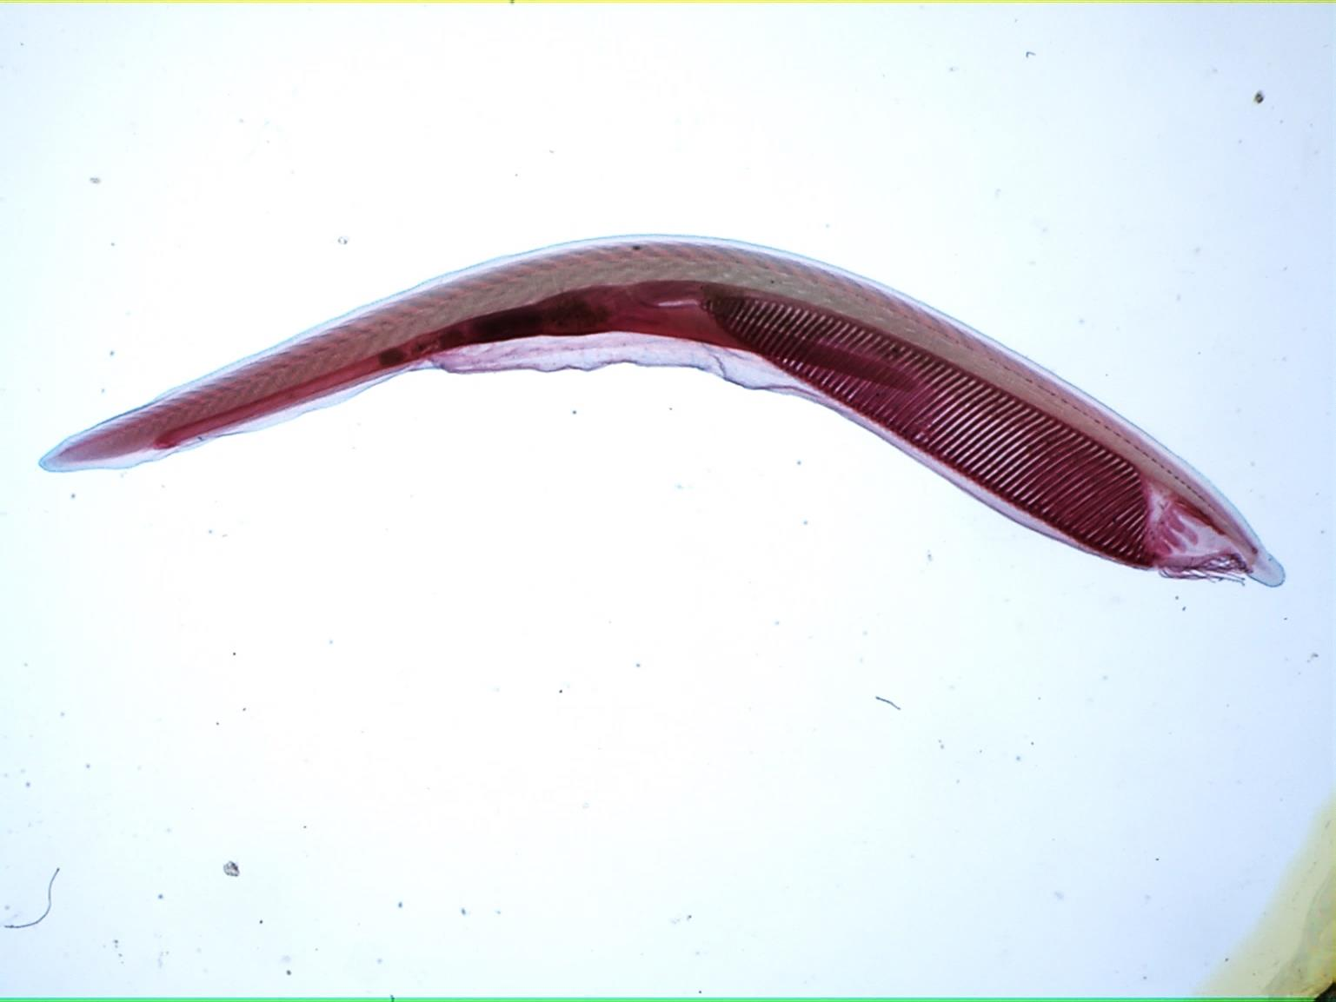
Amphioxus whole mount

Slide 4
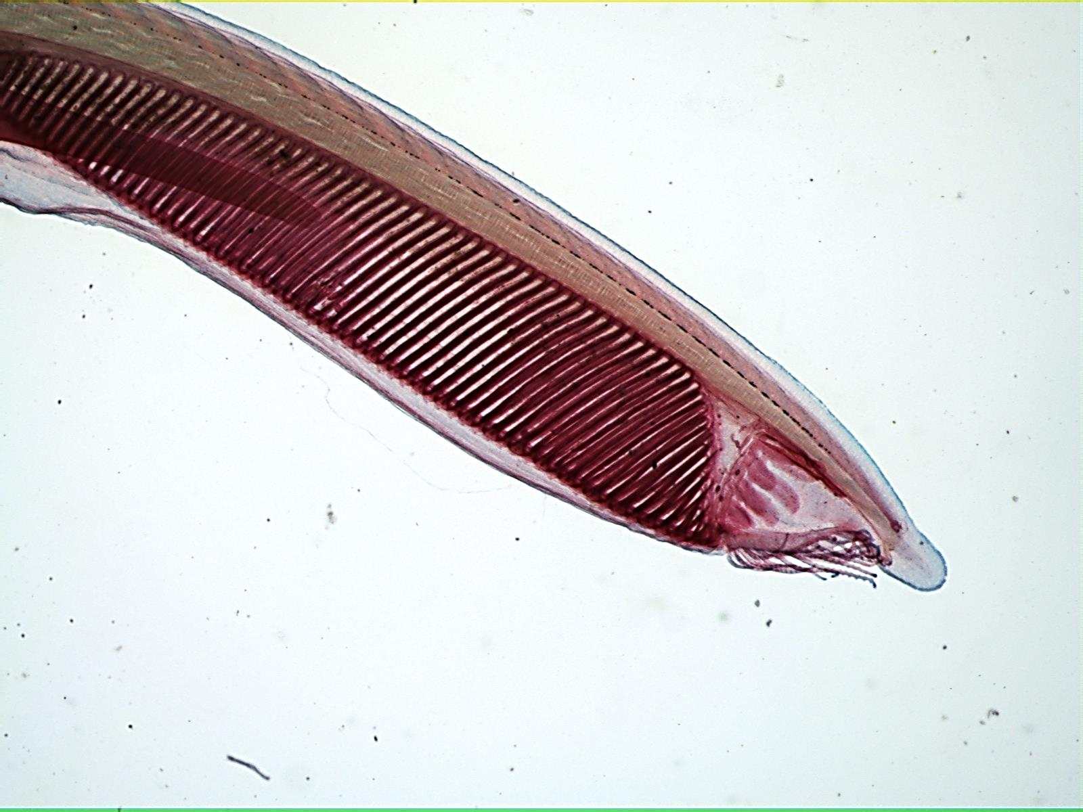
Amphioxus whole mount 40X

Slide 5
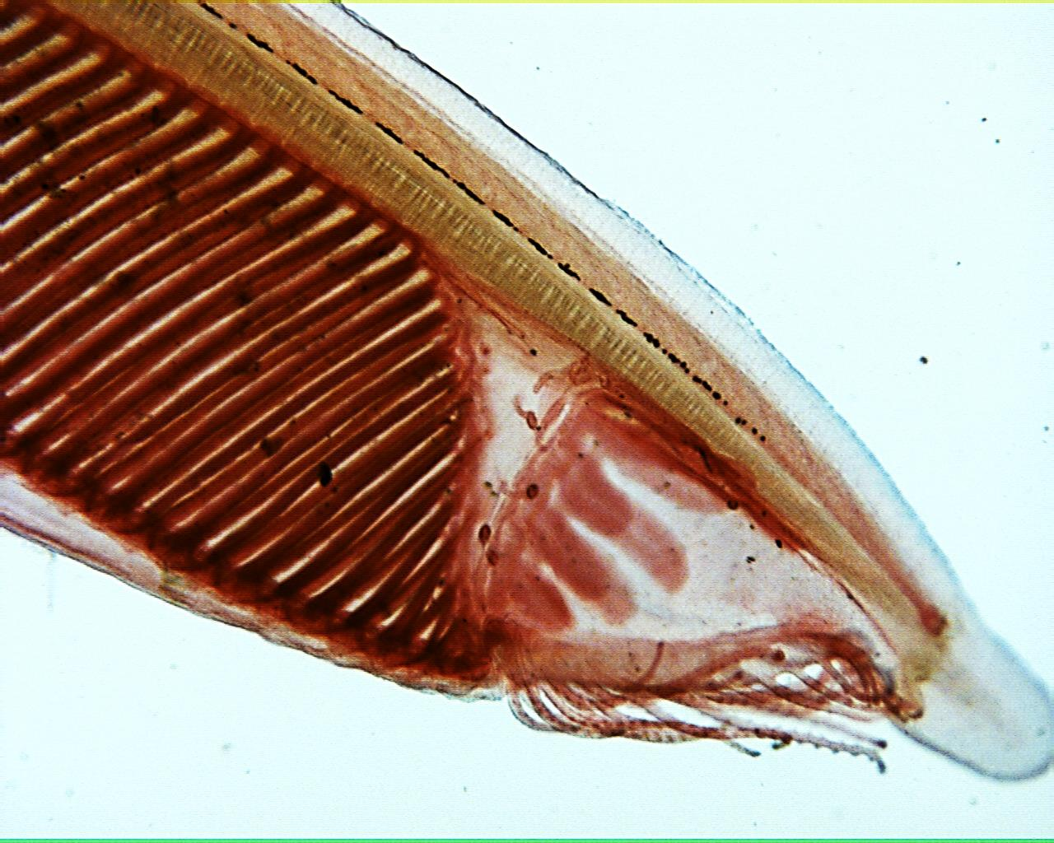
Amphioxius wm 40X

Slide 6
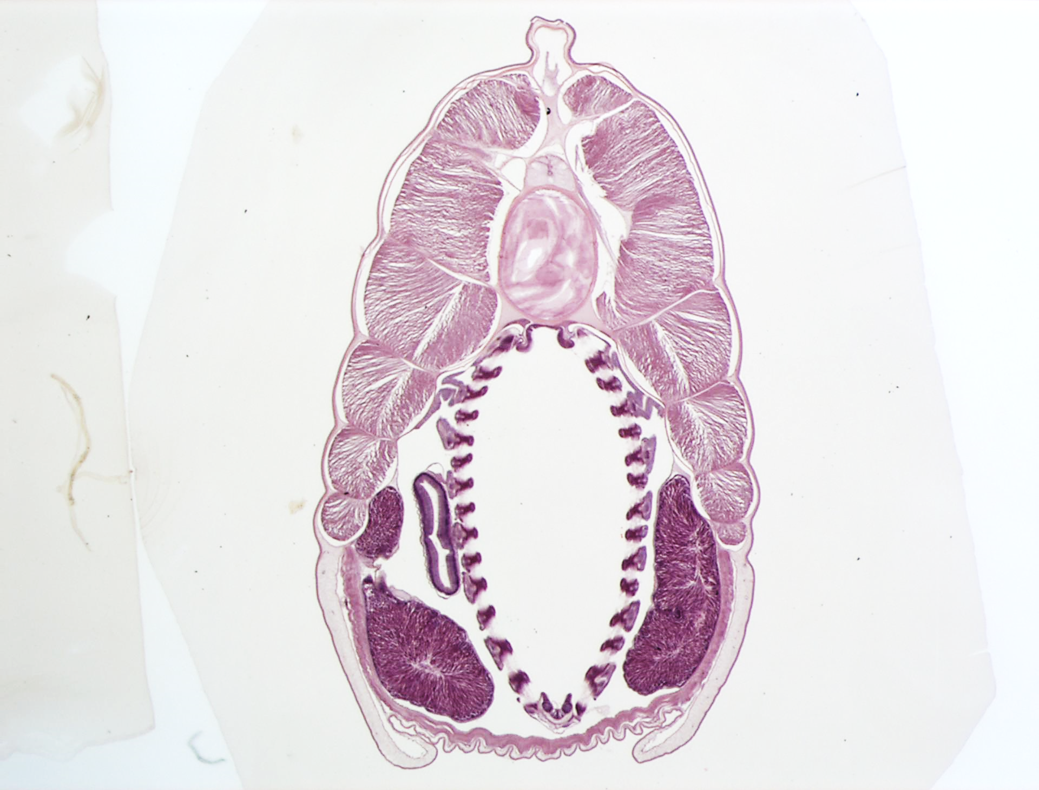
Amphioxus xs

Slide 7
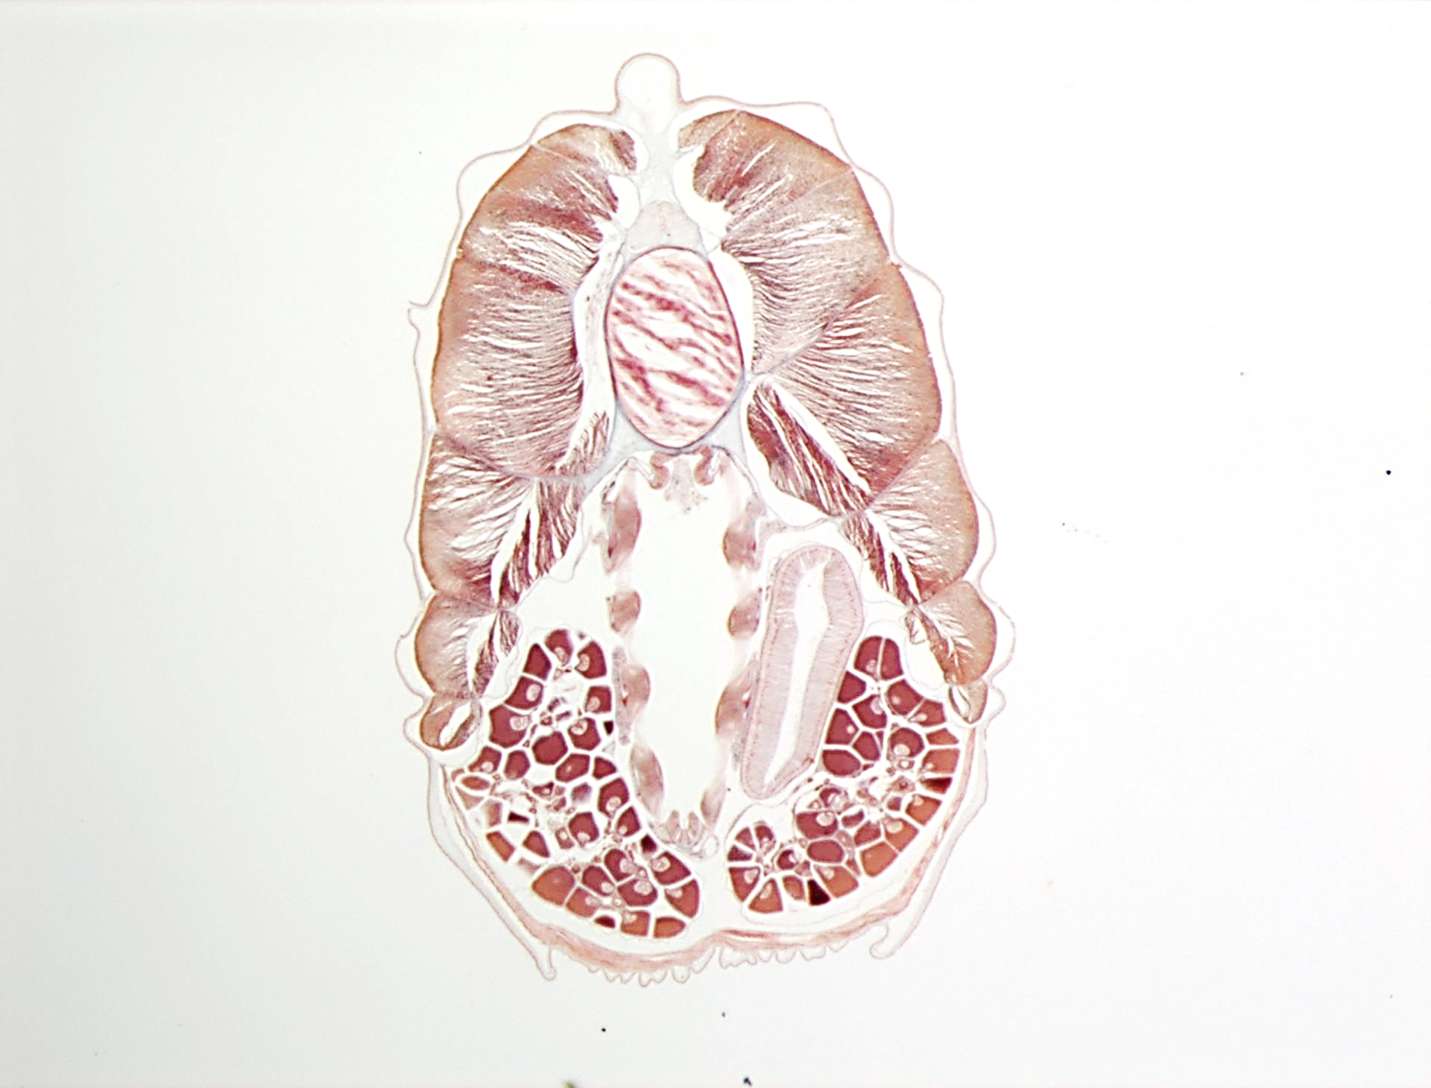
Amphioxus xs

Slide 8
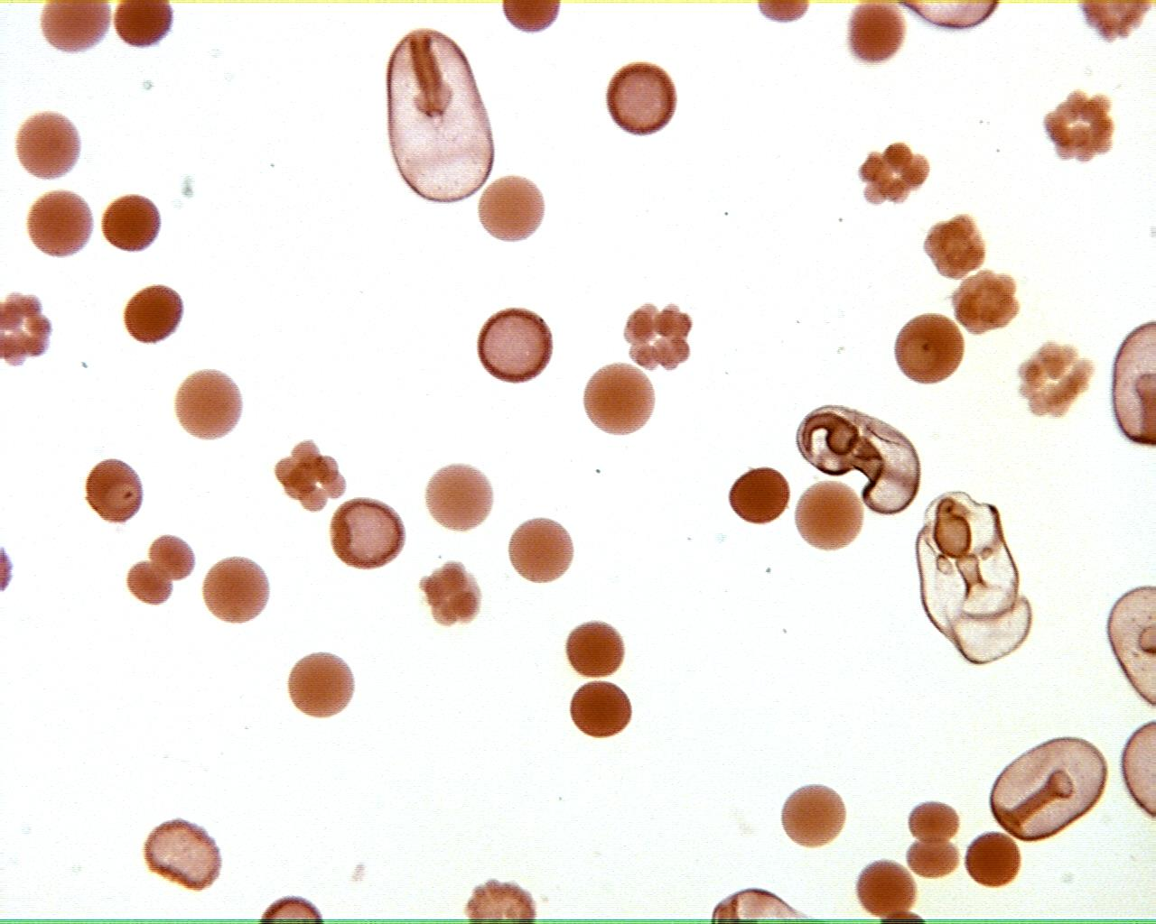
Starfish development 40X

Slide 9
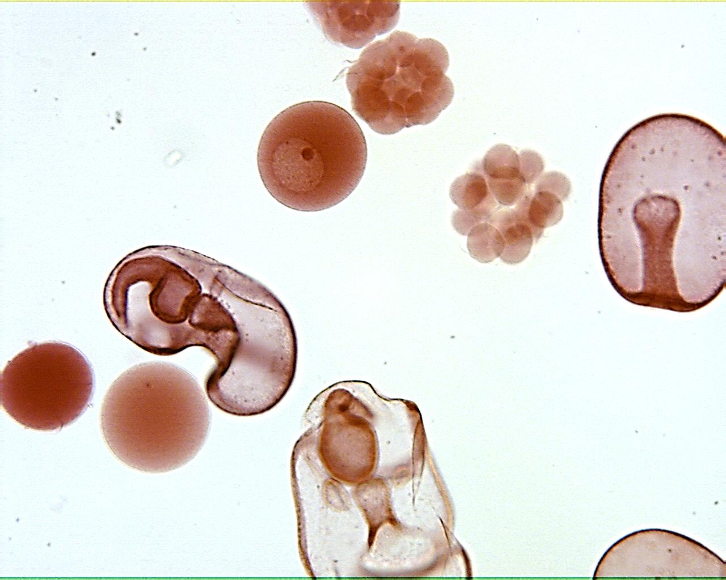
Starfish development 100X

Slide 10
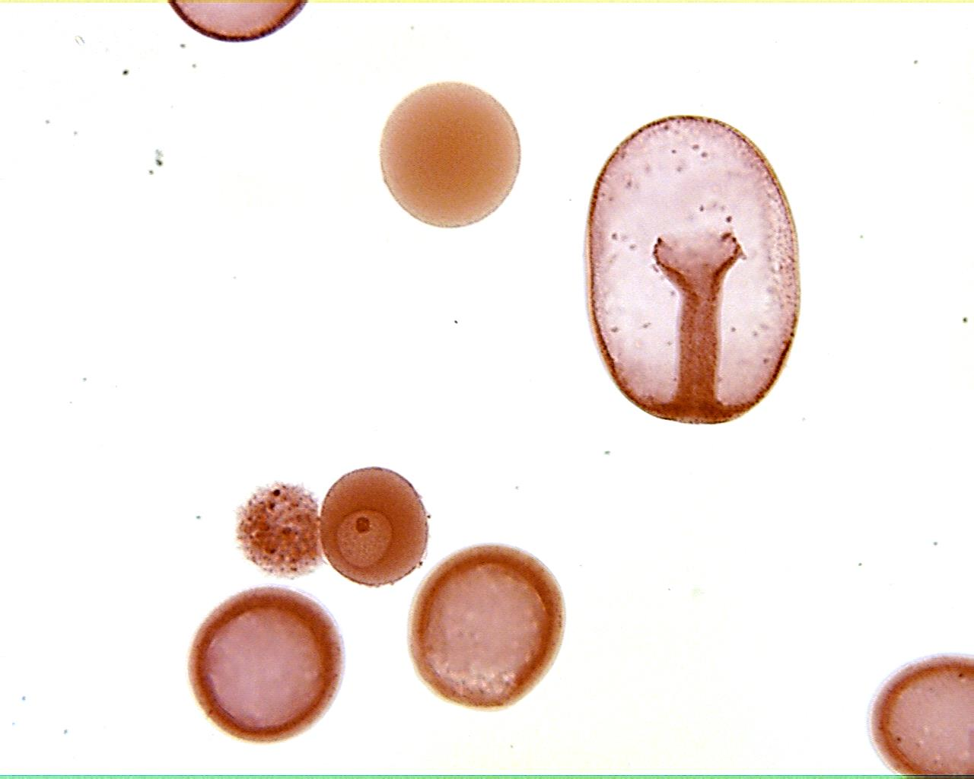
Starfish development 100X

Slide 11
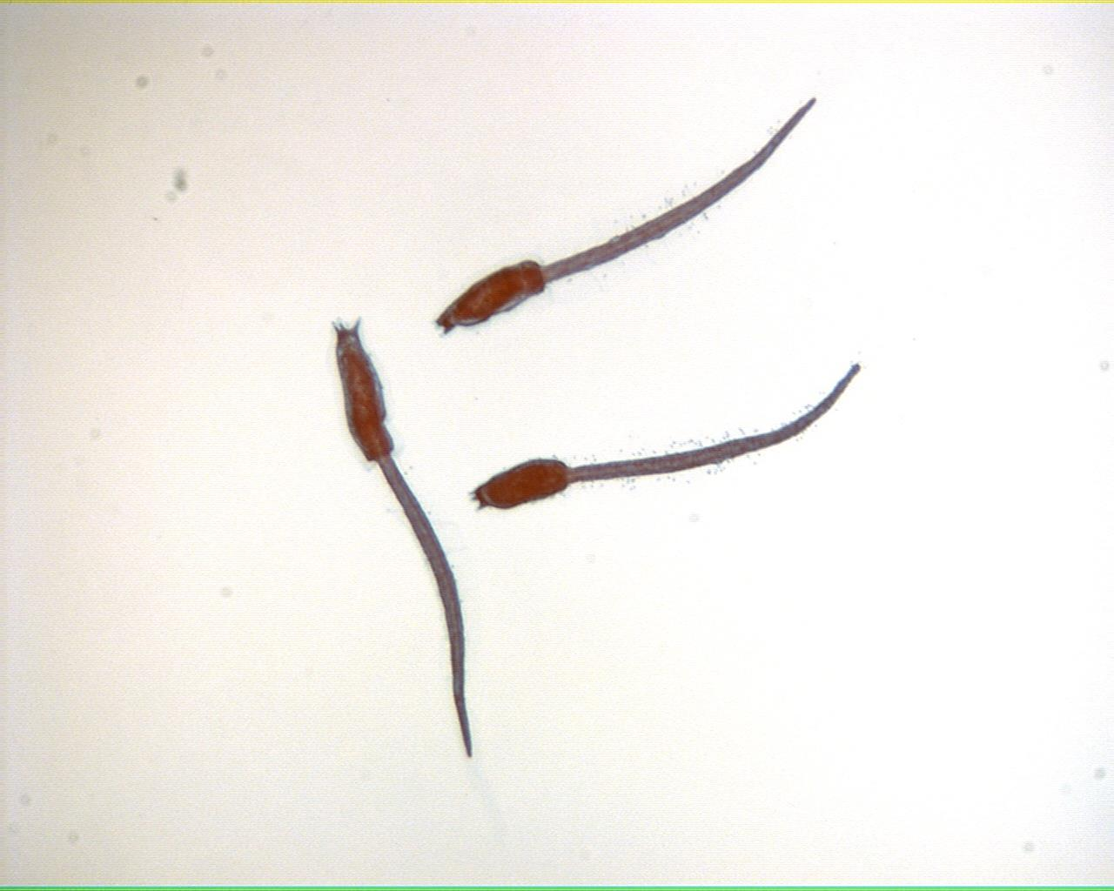
Tunicate larvae 40X

Slide 12
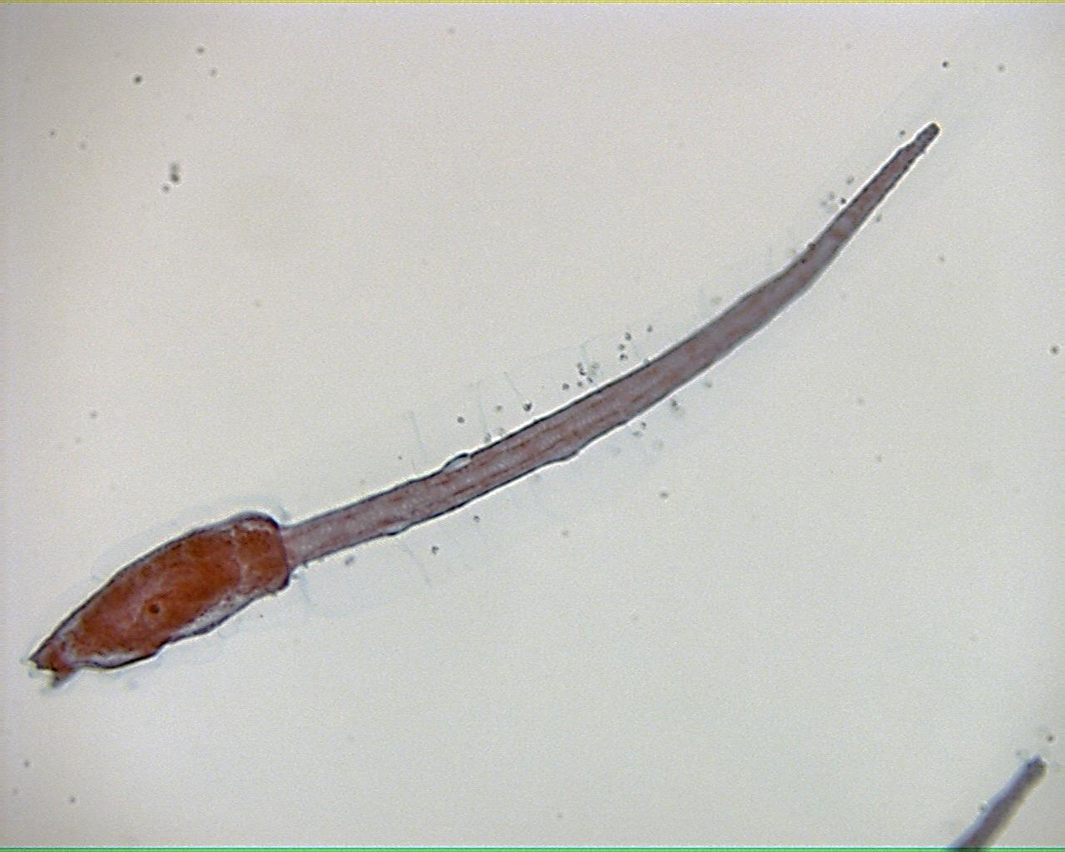
Tunicate larva 100X

Slide 13
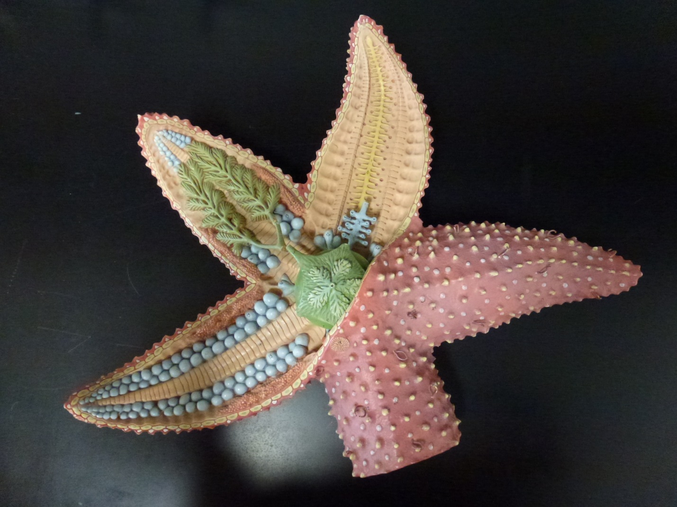
Starfish Model

Slide 14
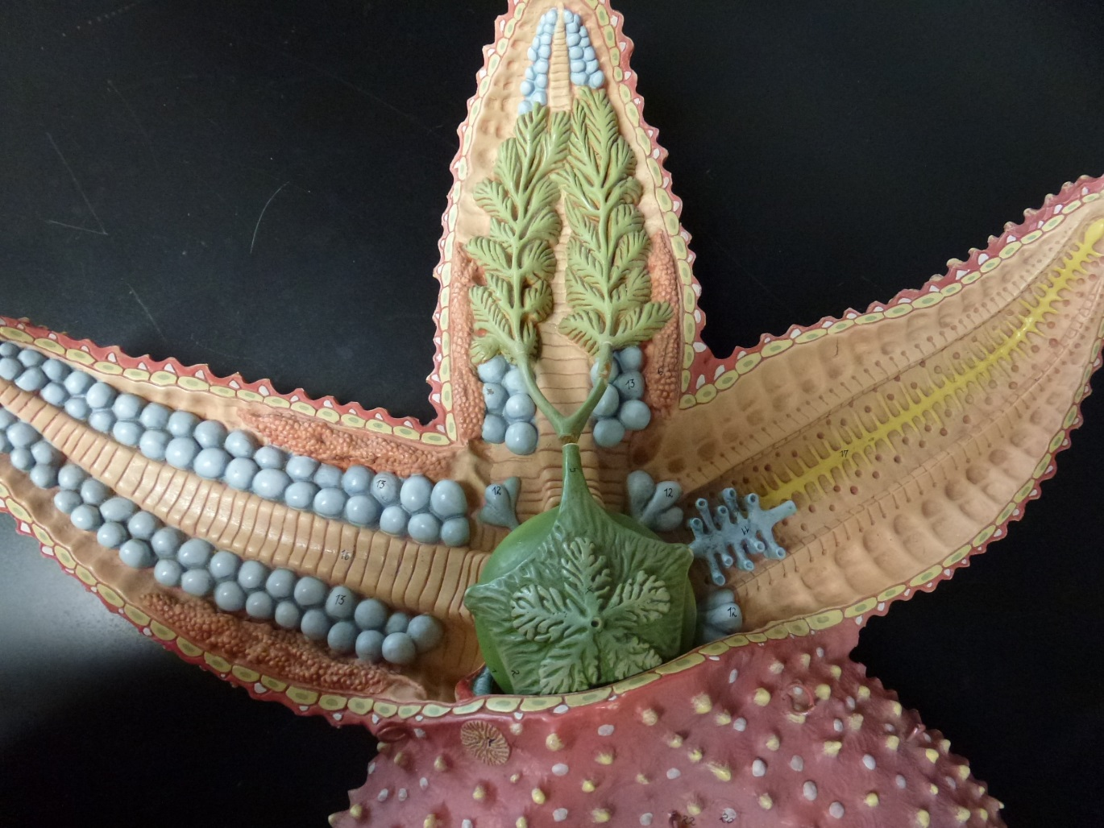
Starfish Model

Slide 15
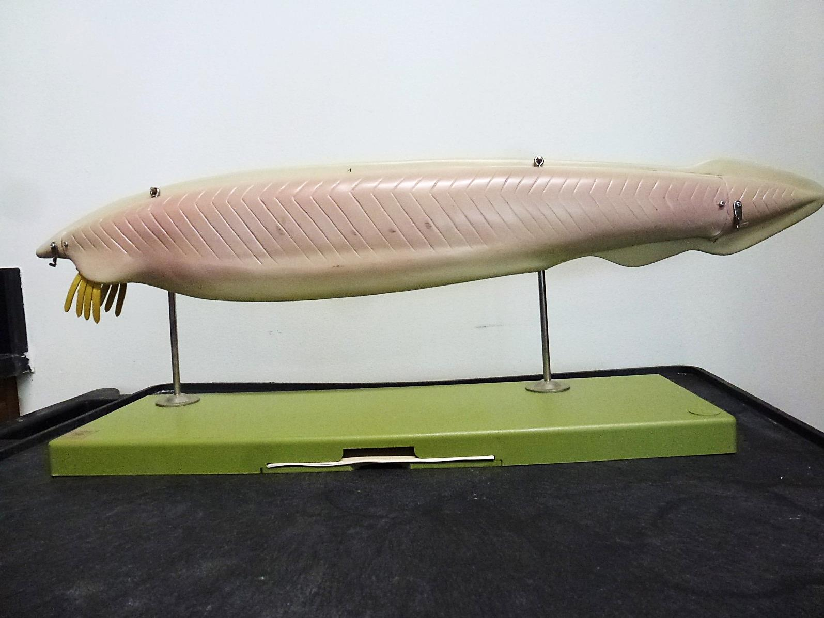
Amphioxus Model

Slide 16
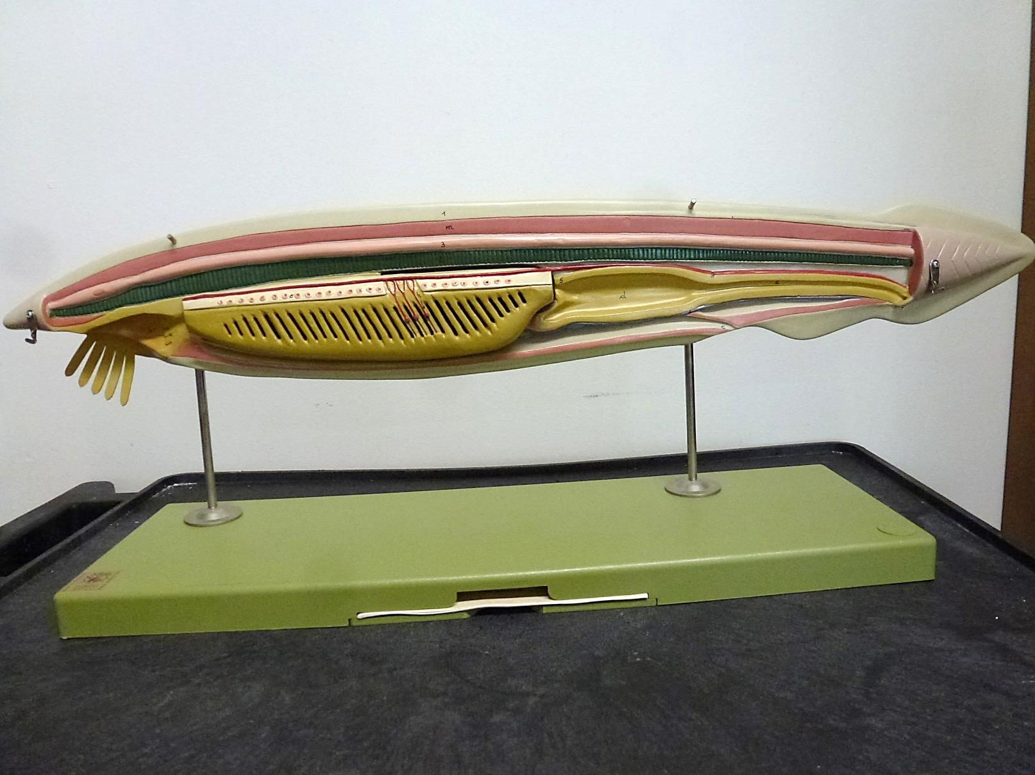
Amphioxus Model

Slide 17
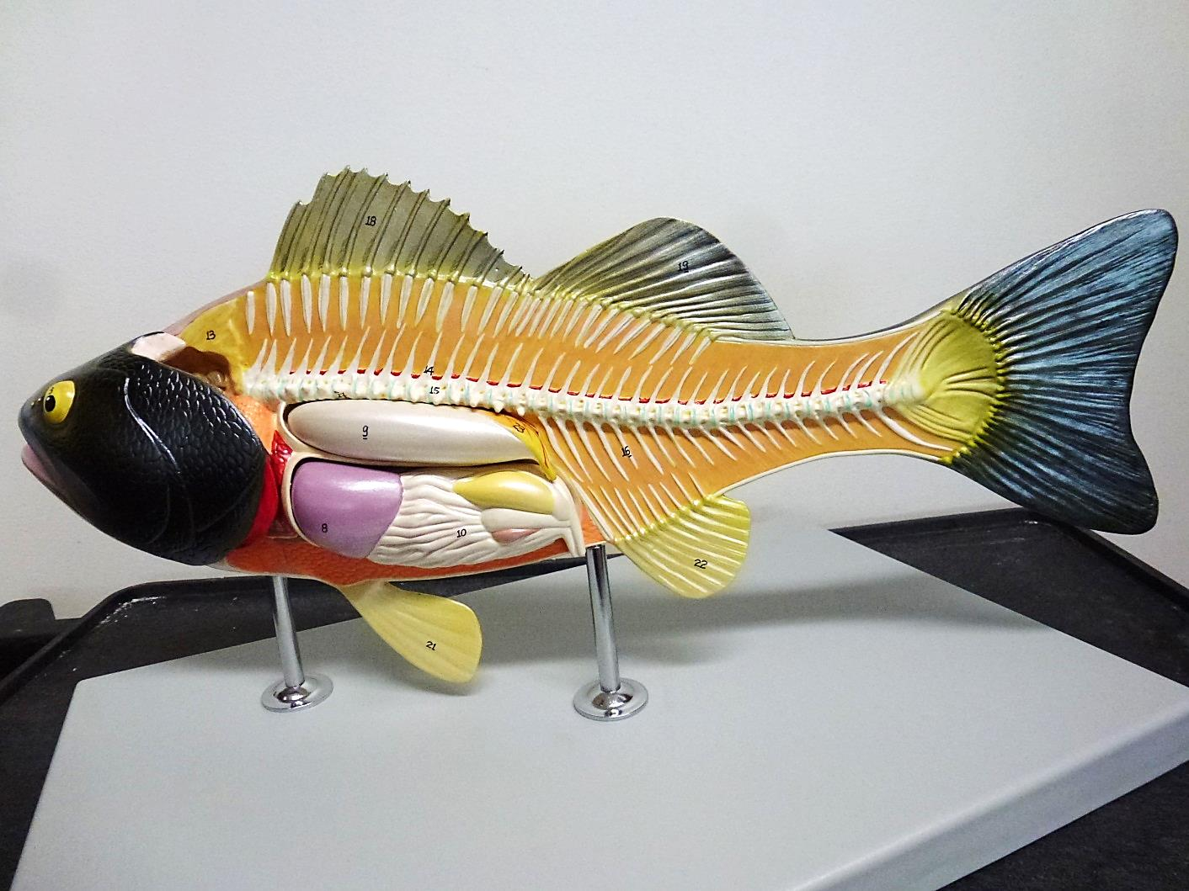
Perch Model

